Slide 1
Terraform Providers
Ow

Slide 2

What is terraform providers ??
Providers are a logical abstraction of an upstream API. They are responsible for understanding API interactions and exposing resources.
Use the Amazon Web Services (AWS) provider to interact with the many resources supported by AWS. You must configure the provider with the proper credentials before you can use it.

Slide 3
How provider will be installed?
The terraform init command initializes a working directory containing Terraform configuration files.
This is the first command that should be run after writing a new Terraform configuration or cloning an existing one from version control. It is safe to run this command multiple times.
This command performs initialization steps in order to prepare the current working directory for use with Terraform.
During init, Terraform searches the configuration to providers and attempts to install the plugins for those providers.

Slide 4
.terraform directory
The .terraform directory is automatically created in the working directory when you run the terraform init command. It serves as a workspace for Terraform, storing various files related to the project's configuration and dependencies.
Inside the .terraform directory, you will find subdirectories such as plugins and modules. The plugins directory contains the Terraform provider plugins required for managing infrastructure resources, while the modules directory holds any locally referenced module

Slide 5
.terraform.lock.hcl file
The .terraform.lock.hcl file is a lock file that specifies the exact versions of the provider plugins and their dependencies that Terraform should use.
The lock file captures the versions of all the providers used in the project, including their dependencies. It helps prevent unintentional upgrades to newer versions of providers, which can potentially introduce breaking changes. By using the lock file, you ensure that everyone working on the project is using the same provider versions.

Slide 6
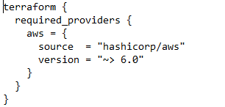
Terraform providers version
The provider version refers to the specific version of a provider plugin that Terraform should use to interact with the target infrastructure.

Slide 7
explanation
terraform: The terraform block is used to configure Terraform itself and specify its behavior.
required_providers: Within the terraform block, you use the required_providers block to declare the providers that your Terraform configuration requires.
aws: Inside the required_providers block, you specify the provider name, in this case, aws.
source: The source attribute indicates the source location of the provider. Here, the AWS provider is sourced from hashicorp/aws, which refers to the official provider maintained by HashiCorp.
version: The version attribute specifies the required version constraint for the provider. In this example, ~> 6.0 indicates that Terraform should use any version greater than or equal to 6.0 but less than the next major version.

Slide 8
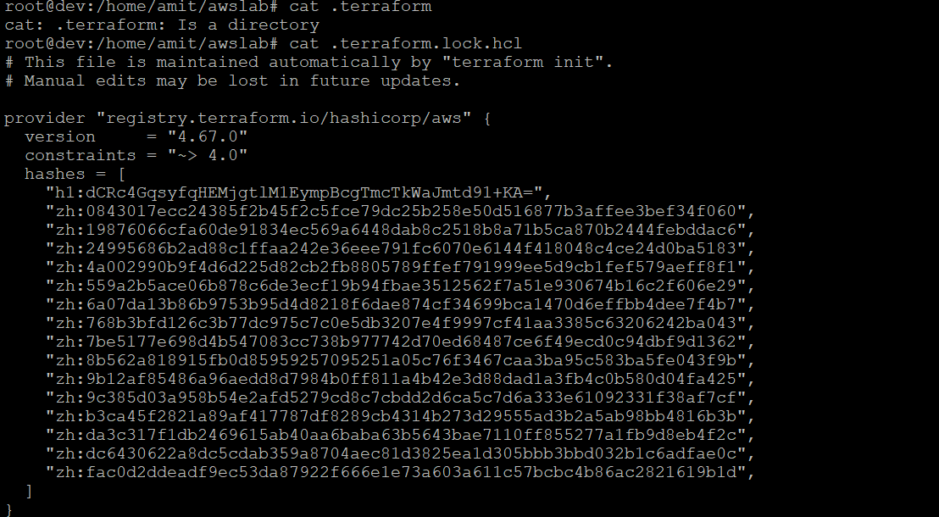
..

Slide 9
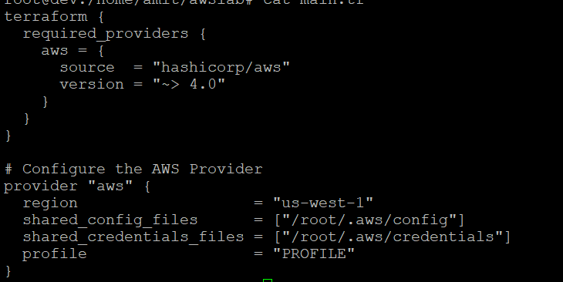
..

Slide 10



